Slide 1

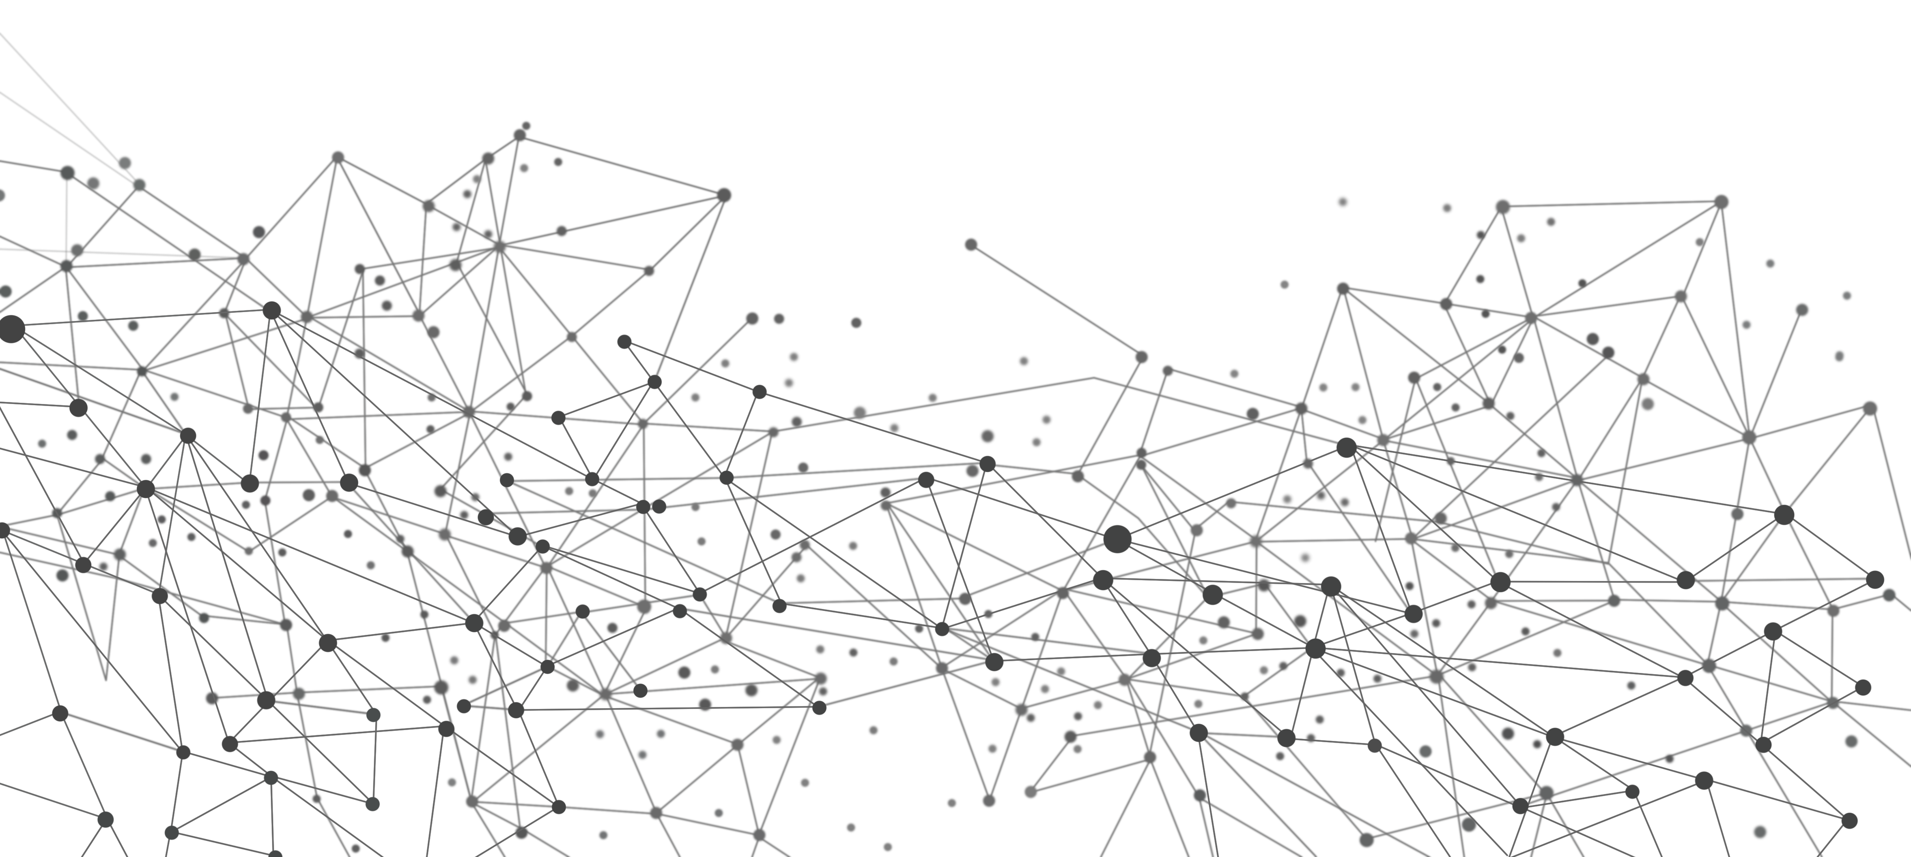
MUSIC GENRE CLASSIFICATION USING DEEP LEARNING

Slide 2

INTRODUCTION
Music genre classification plays a crucial role in the ever-evolving world of music streaming and applications. With the rise of platforms like Spotify, Apple Music, Shazam, SoundCloud, Deezer among many others, it has become increasingly important to develop technologies that can accurately categorize music into various genres.
Our model utilizes an algorithm that considers multiple audio-based factors, such as the type of instruments used, bass characteristics, frequency patterns, and chroma vectors, to determine the genre of a given music file.
The genres we focus on include blues, classical, country, disco, hip-hop, jazz, metal, pop, reggae, and rock:
Blues wails through soulful guitar and harmonica; classical symphonies soar with strings, brass, and woodwinds; country twangs with acoustic guitars and fiddles; disco grooves with pulsating basslines and funky keyboards; hip-hop rhymes over beats crafted with drum machines and samples; jazz swings with improvisation on saxophone, trumpet, and piano; metal shreds with electric guitars and thunderous drums; pop sparkles with catchy hooks and synthesizers; reggae grooves to the rhythm of bass guitar and drums; and rock roars with power chords played on electric guitars and thundering basslines.

Slide 3
WORKING
Music genre classification using deep learning involves training models to automatically classify audio files into different genres based on their content. Deep learning algorithms, such as convolutional neural networks (CNNs) and recurrent neural networks (RNNs), are commonly used for this task.
Dataset - To train the deep learning models, a dataset of music files with labeled genres is required. One example of such a dataset is the GTZAN dataset, which contains 1000 music files with ten different genres. The dataset is typically preprocessed to extract relevant features from the audio files, such as spectrograms or mel-frequency cepstral coefficients (MFCCs) .
Feature Extraction - Audio features need to be extracted from the music files. Commonly used features include spectrograms, which visualize audio signals based on their frequency components, and MFCCs, which capture the shape of the power spectrum of a sound signal. These features provide representations of the audio files that can be used as input to the models.
Model Training - Once the features are extracted, deep learning models can be trained to classify the music files into different genres. CNNs are often used for this task, as they can effectively learn hierarchical representations. After training the models, their performance is evaluated using a separate validation or test set.

Slide 4
ARCHITECTURE
INPUT Layer - The input layer takes in a feature vector of shape (498).
Hidden Layer 1 - A dense layer of 300 units with ReLU activation function.
Hidden Layer 2 - A dense layer of 200 units with ReLU activation function.
Hidden Layer 3 - A dense layer of 100 units with ReLU activation function.
OUTPUT Layer - The output layer has 3 neurons, representing the probabilities of the input belonging to each of the three music genres (pop, hiphop, and metal).
OPTIMIZER - RMSprop is an optimization algorithm that adapts the learning rate based on the average of recent gradients. It helps in faster convergence and better performance, especially in scenarios with sparse gradients (79% Accuracy). ADAM – 61% Accuracy.
LOSS FUNCTION - The loss function chosen for this model is the Sparse Categorical Cross-entropy. It is suitable for multi-class classification problems and it aims to minimize this loss function during training.
EPOCHS - The model is trained for 200 epochs.

Slide 5
APPLICATIONS
Music Recommendation: Music genre classification is used as a fundamental step in building personalized music recommendation systems. By classifying music into different genres, the system can suggest songs or playlists that align with the user's preferences.
Music Streaming Services: Music genre classification is employed by music streaming platforms to organize their vast libraries and improve user experience. It allows users to explore and discover music based on specific genres of interest.
Music Analysis and Research: Music genre classification is used in music analysis and research to study trends, patterns, evolution and characteristics of different genres.
Music Licensing, Marketing and Copyright: Music genre classification can assist in music licensing and copyright management. By accurately classifying music into genres, it becomes easier to categorize and manage licensing agreements for different genres of music. It can aid music producers and marketers in understanding the target audience and tailoring their music production and marketing strategies accordingly.
Music Education: Music genre classification can be used in educational settings to teach students about different genres of music. It provides a structured way to introduce students to various musical styles and helps in developing their musical knowledge and appreciation.

Slide 6
TECHNOLOGICAL ADVANCEMENTS
LSTM (Long Short-Term Memory) Networks: LSTM networks have started to be widely used in music genre classification. These networks are capable of capturing temporal dependencies in music data, making them suitable for analyzing sequential audio data. For example, a proposed LSTM architecture for music genre classification can provide classifications for more than one genres when combined with CNNs and dense layers.
Feature Extraction: Mel-frequency Cepstral Coefficients (MFCCs), Spectral Centroid, Chroma Features, Tempo, Rhythm Patterns, Harmonic Features, Zero Crossing Rate and Energy are just some of the most important features.
Natural Language Processing: NLP techniques have been applied in analyzing lyrics to determine the genre of a song. NLP methods and models can be utilized to extract meaningful information from the lyrical text - one approach involves using machine learning models like Support Vector Machines (SVMs) along with GloVe embeddings. With the help of NLP, songs can be directly related to regional languages and will provide other references to culture.
Transfer Learning: Allows models trained on larger, more distinguished and advanced music datasets to be fine-tuned or used as feature extractors for smaller datasets. Supervised learning methods are used to analyze music based on known patterns and features.

Slide 7
THANK YOU

